Slide 1
Team-274 DevOps Track
Pro Shop Project
Abdelrahman Ayman
Abdelrahman Mahmoud
Abdullah Hamada
Karim Fathy

Slide 2
Presentation Main Points
Introduction and Project stack
Containerzation and its orchesrtration
IaC & configuration Management
CI/CD pipline
Monitoring and Observability

Slide 3
01
Intro

Slide 4
Introduction
Project Overview
Frontend
Backend
DevOps Technologies

Slide 5
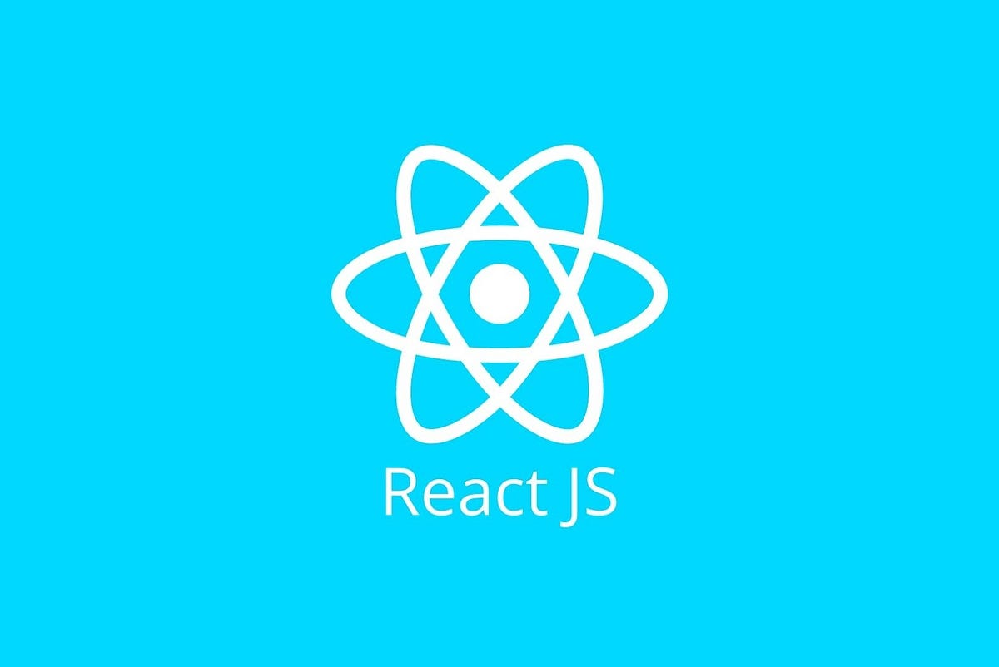
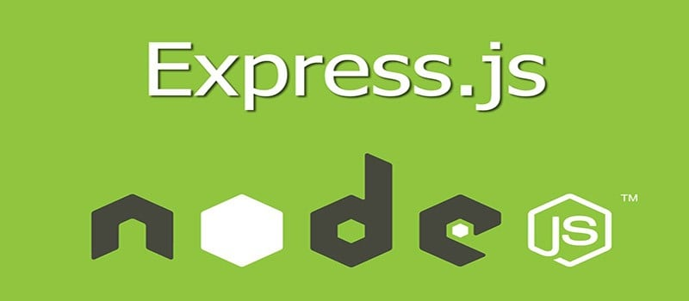

Project Overview
Node.js with Express.js framework
Stack
containerization
Orchestration
IaC
Mern
Stack
Docker & Docker compose
Using Kubernetes
Terraform and AWS
Pipeline
Security
GitOps
Monitoring
DataBase
Gitlab
Trivy & npm audit
ArgoCD and Helm
Prometheus & Grafana
Mongo
Backend
Stack of our project
Frontend
React.js

Slide 6
Stack of our project
Frontend
DataBase
Backend
React.js
Mongo
Node.js with Express.js framework

Slide 7
02
Containerizing

Slide 8
Containerization and Orchestration
Docker
First For Backend

Slide 9
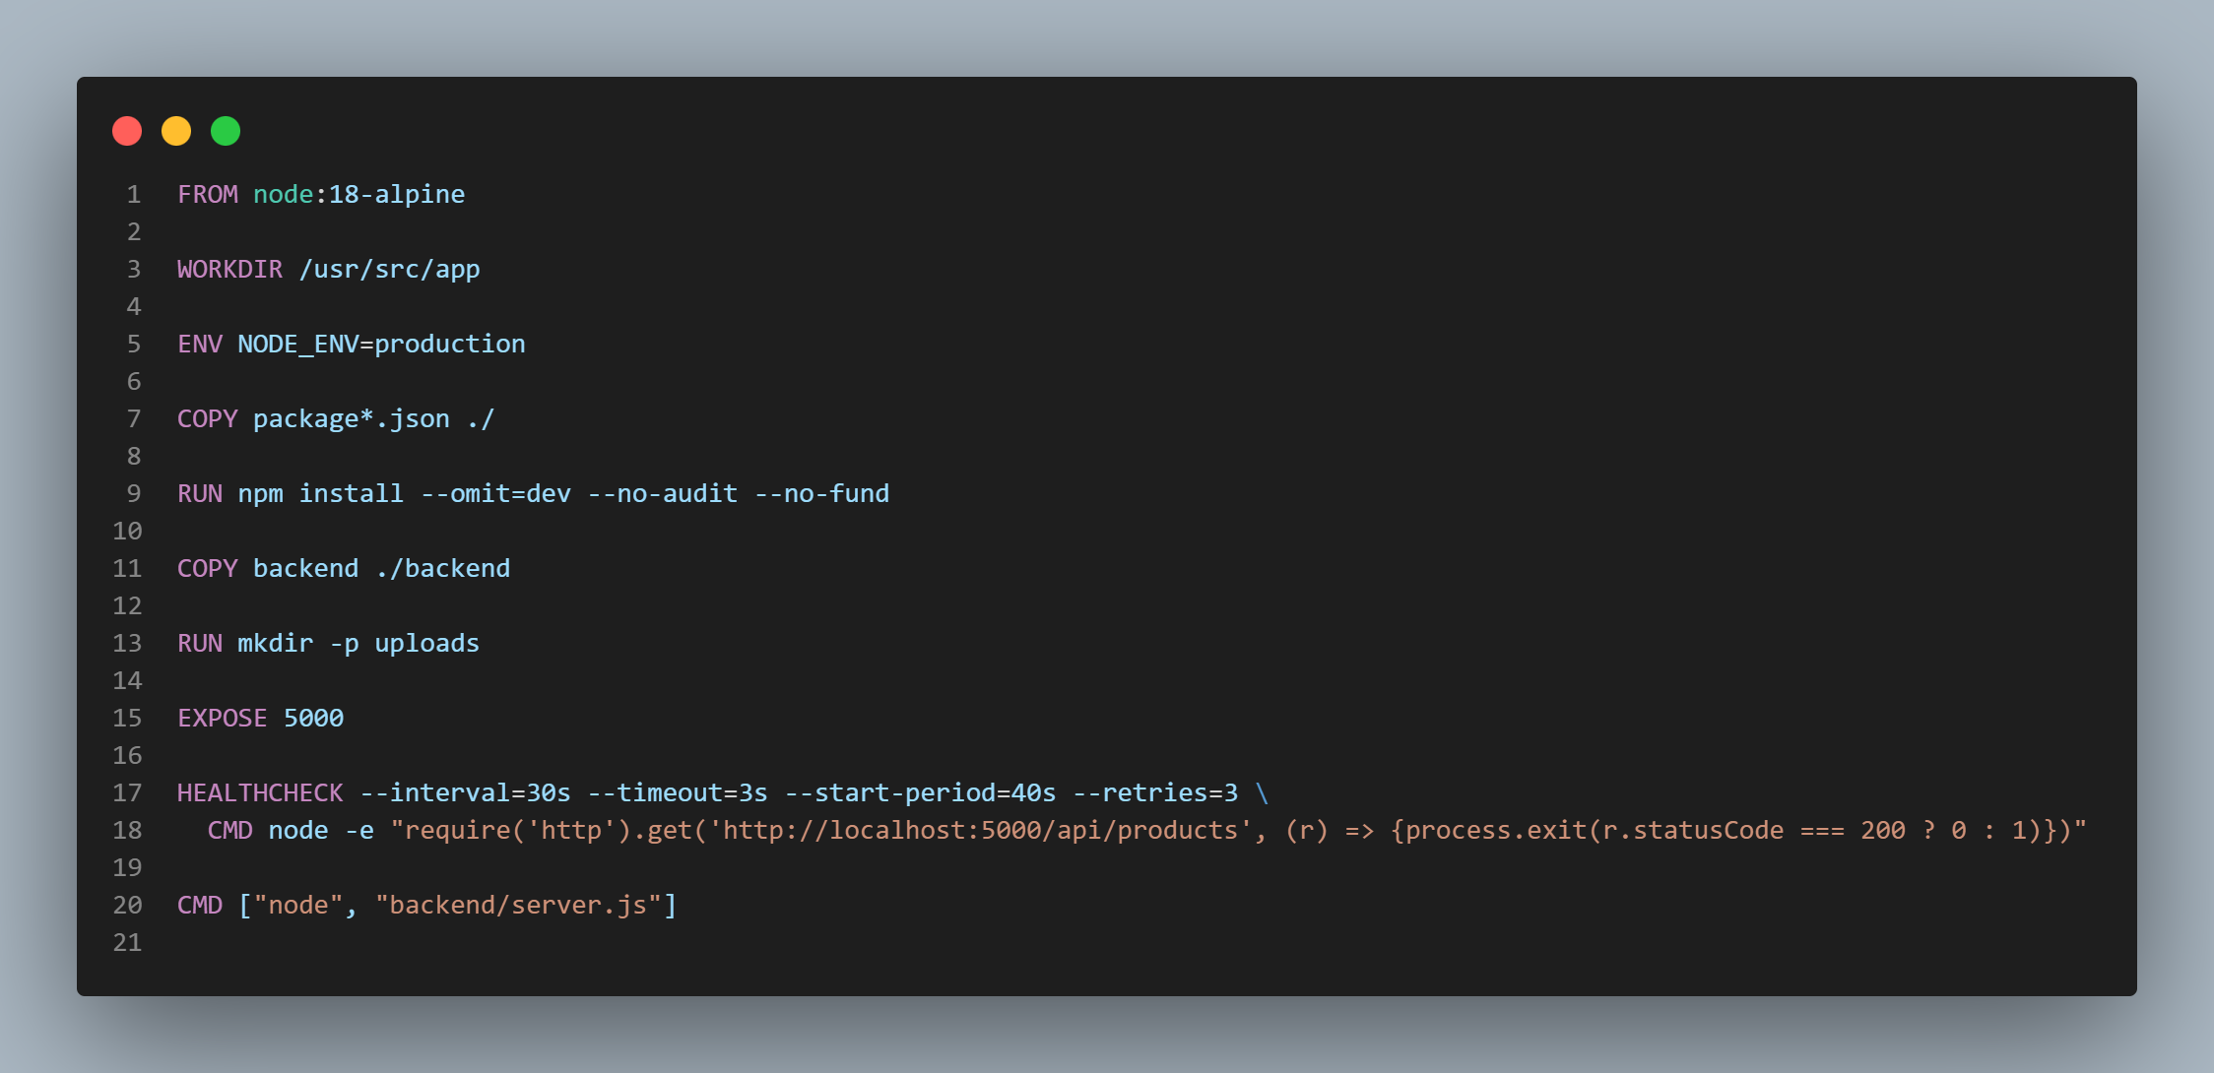

Slide 10
Containerization and Orchestration
Docker
First For Backend
Docker
For Frontend

Slide 11
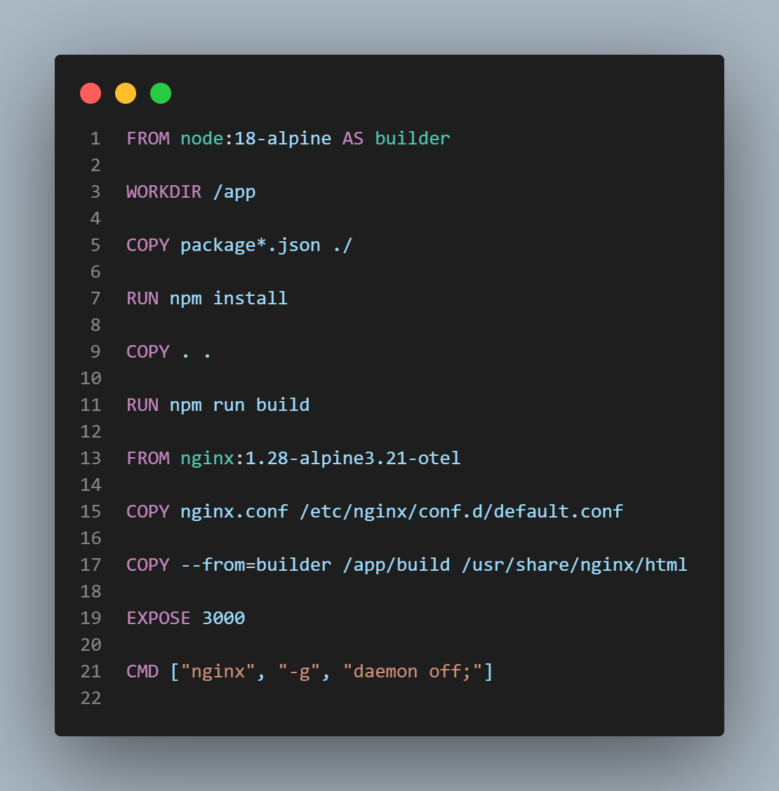

Slide 12
Containerization and Orchestration
Docker
First For Backend
Docker
For Frontend
Compose
Compose all the project

Slide 13
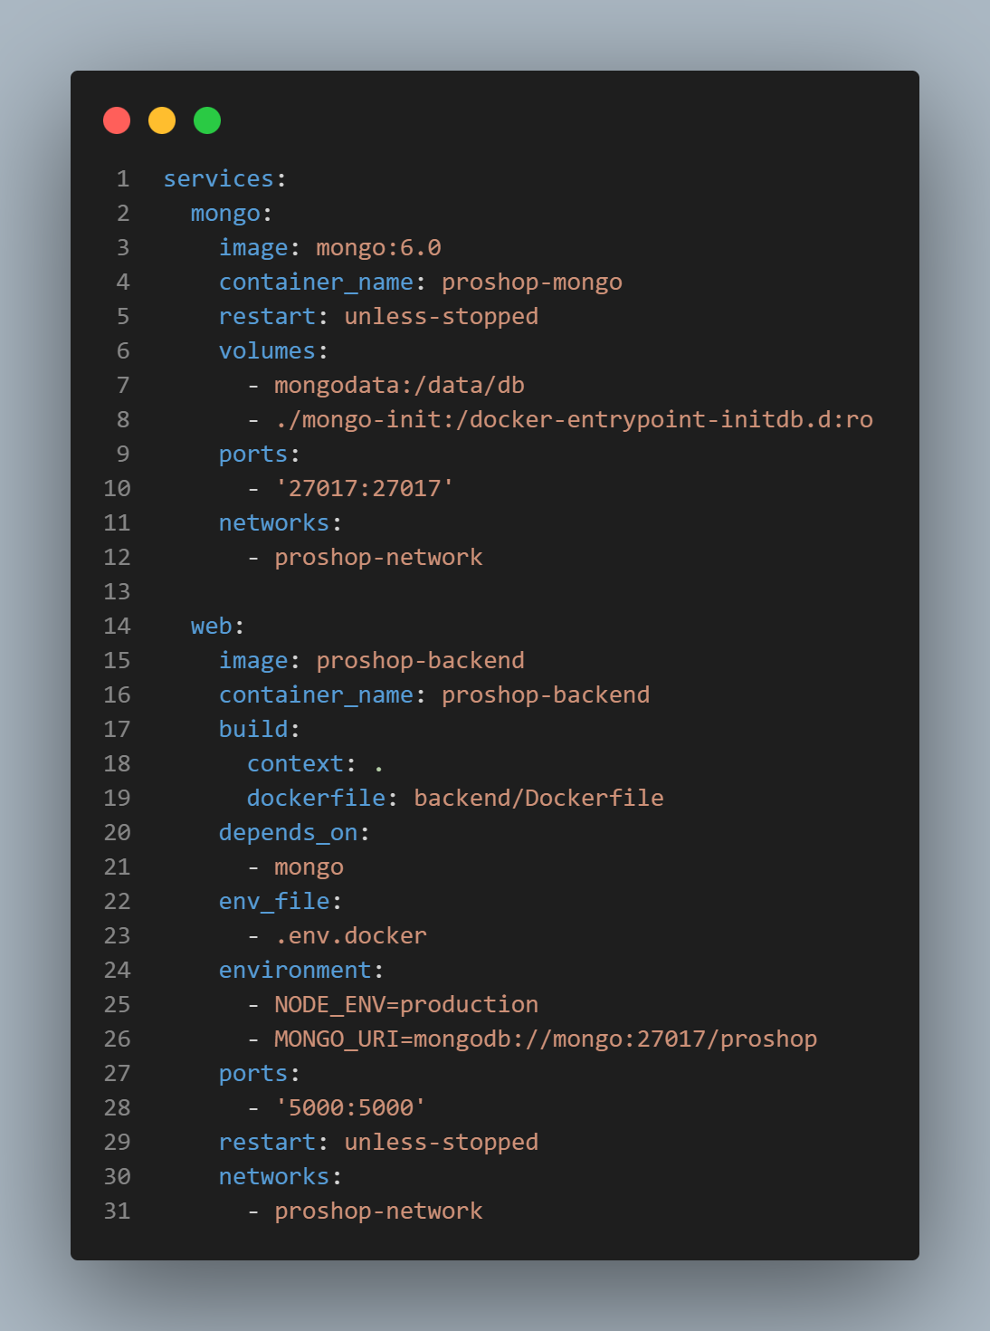

Slide 14
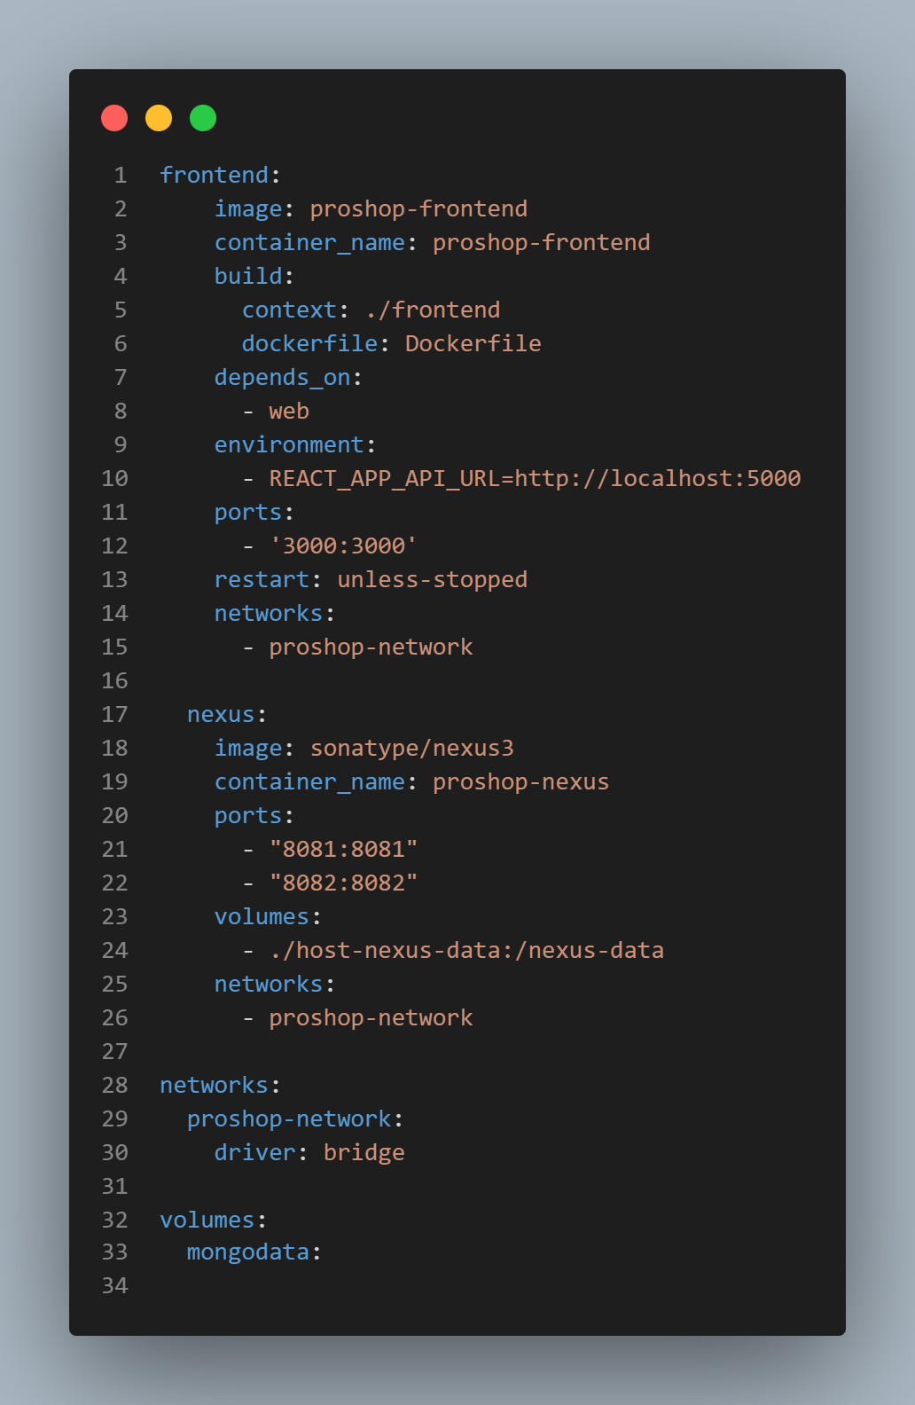

Slide 15
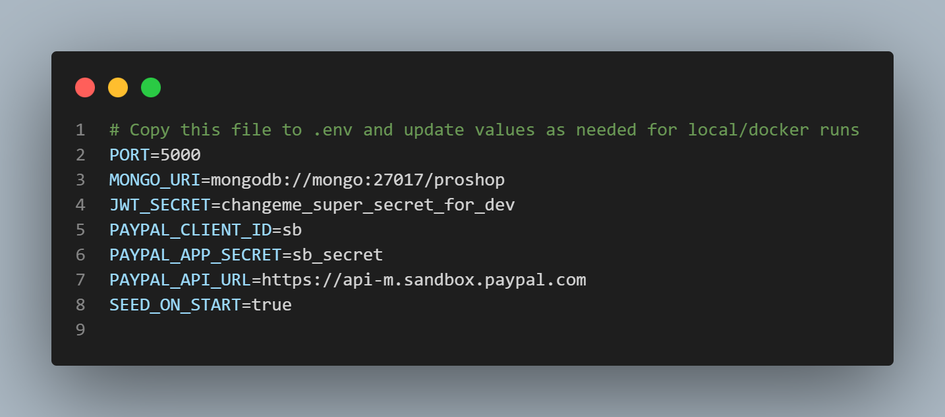
Also .env file

Slide 16
03
Kubernetes

Slide 17
Containerization and Orchestration
Docker
For Backend
Docker
For Frontend
Compose
Backend& DB K8S
Compose all the project
Manifests

Slide 18
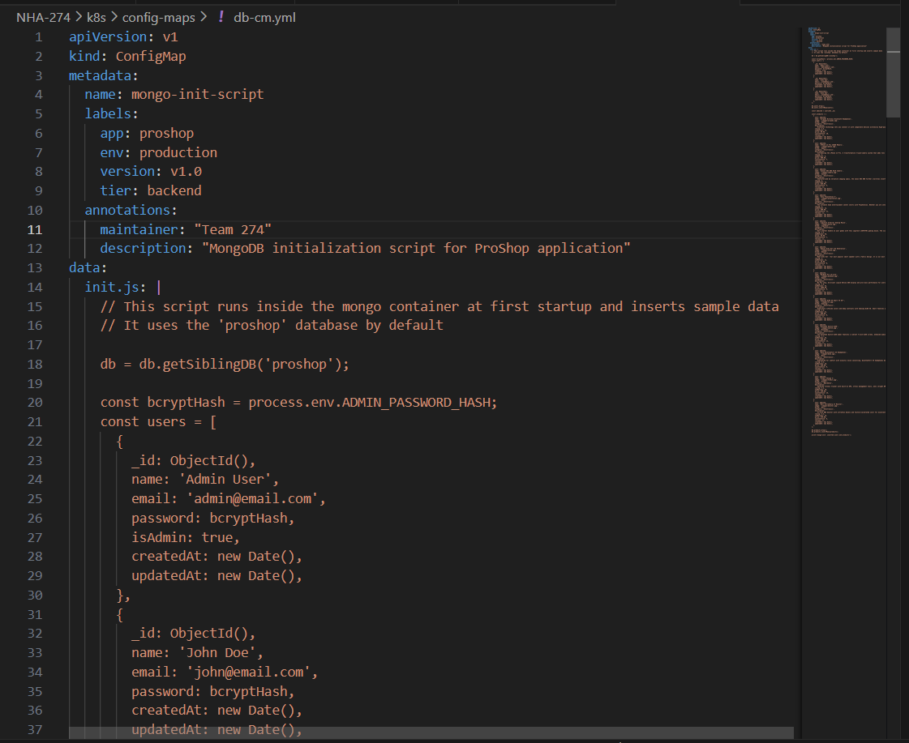
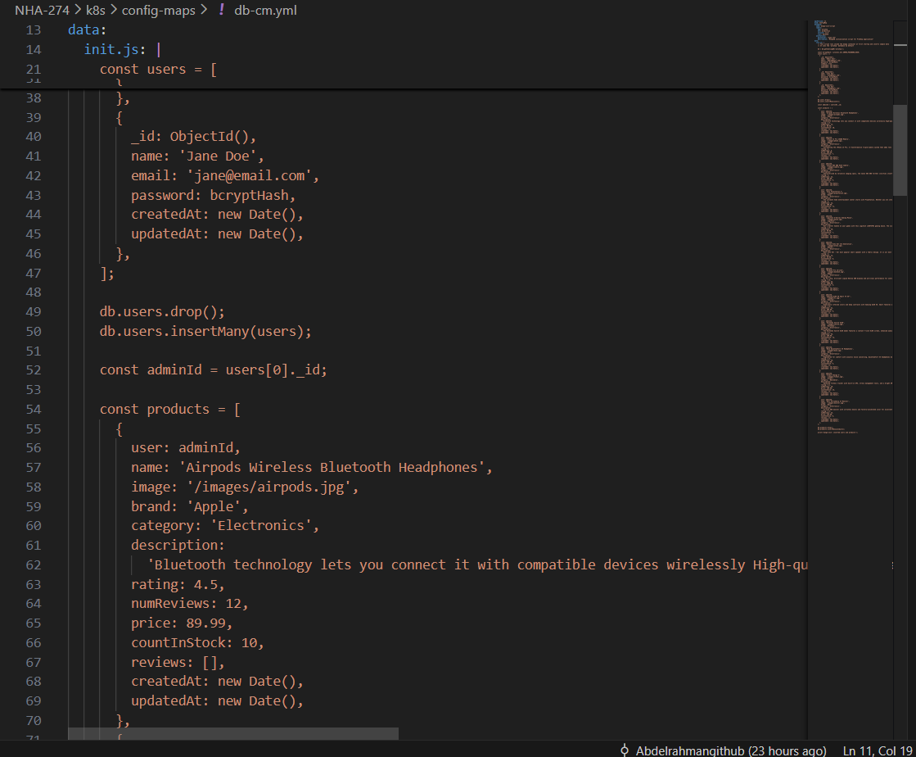
Config Maps

Slide 19
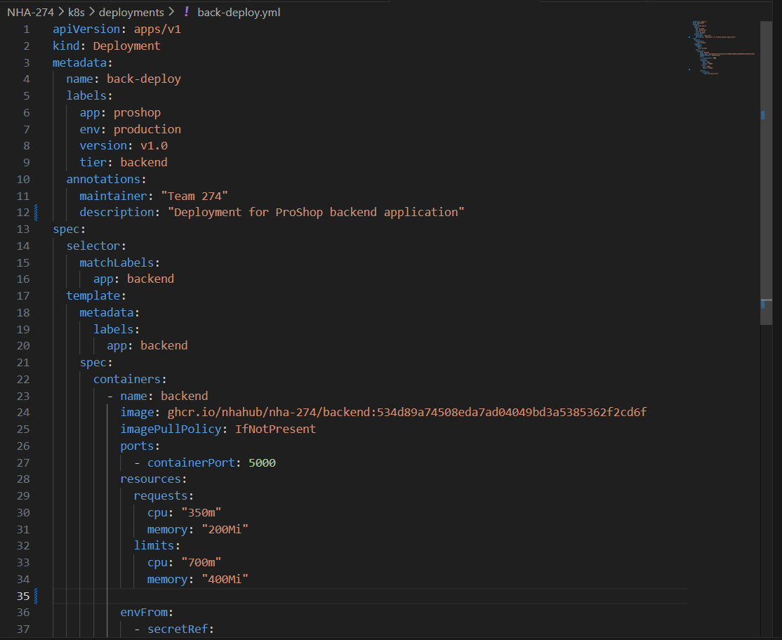
Deployment Backend

Slide 20
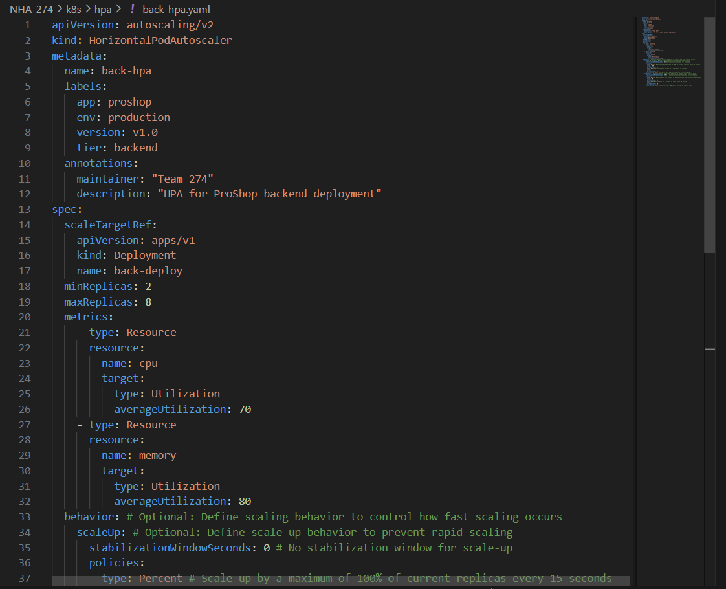
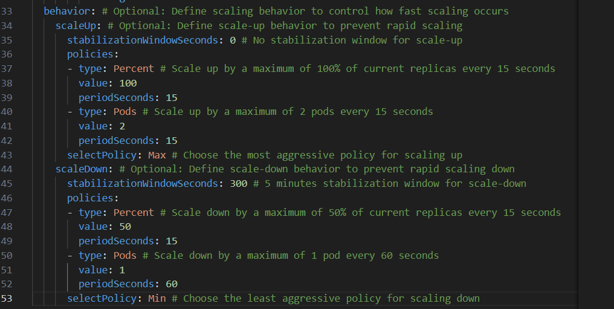
HPA

Slide 21
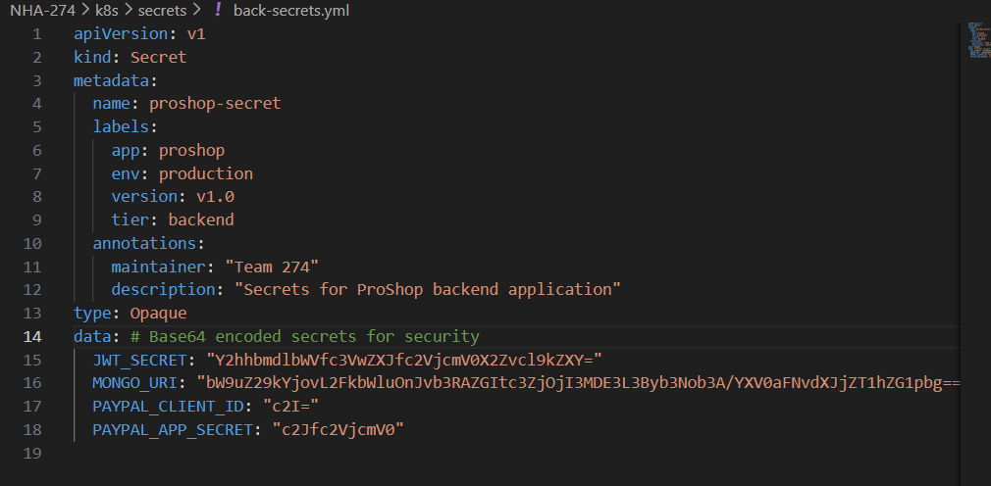
Secrets to be continued…

Slide 22
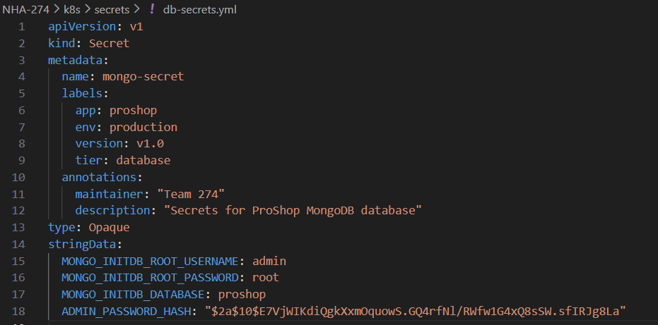
Secrets to be continued…

Slide 23
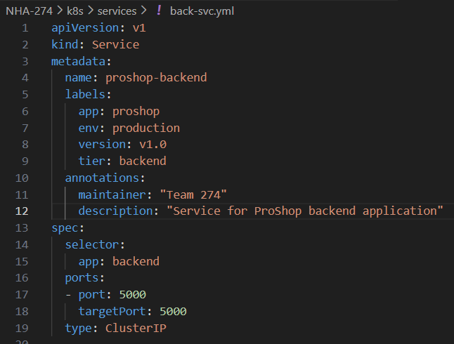
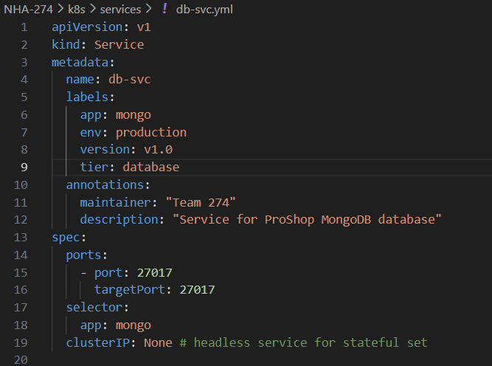
Services

Slide 24
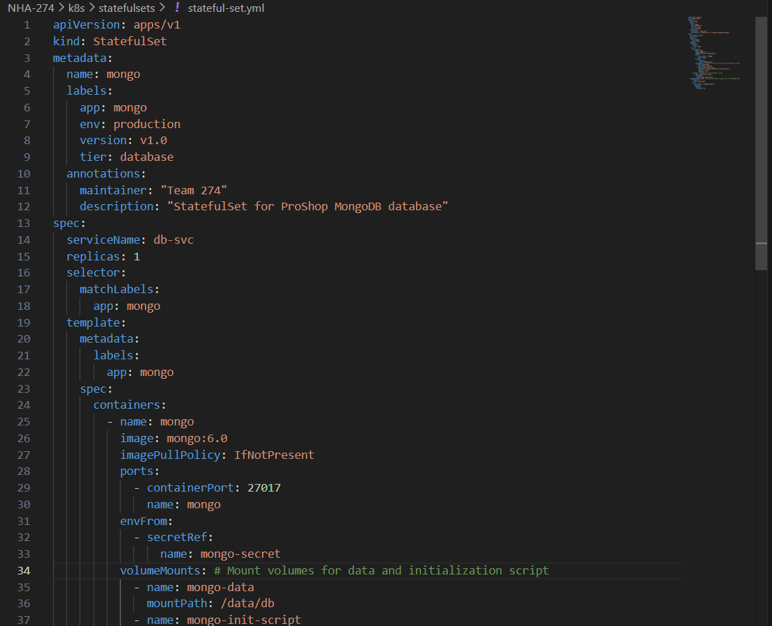
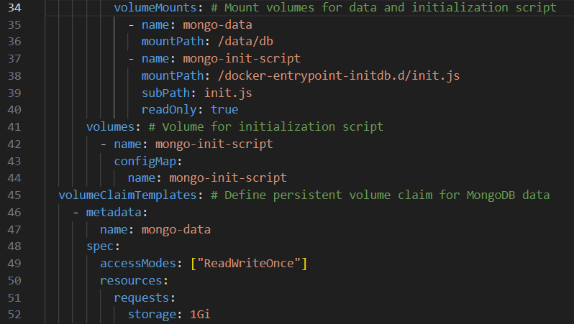
Statefulset

Slide 25
Containerization and Orchestration
Docker
Frontend K8S
For Backend
Manifests
Compose
Docker
For Frontend
Compose
all the project
Back&DB K8S
Manifests

Slide 26
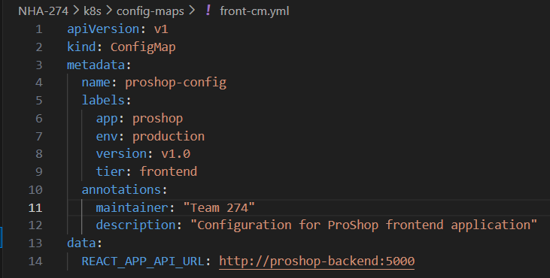
Config Maps

Slide 27
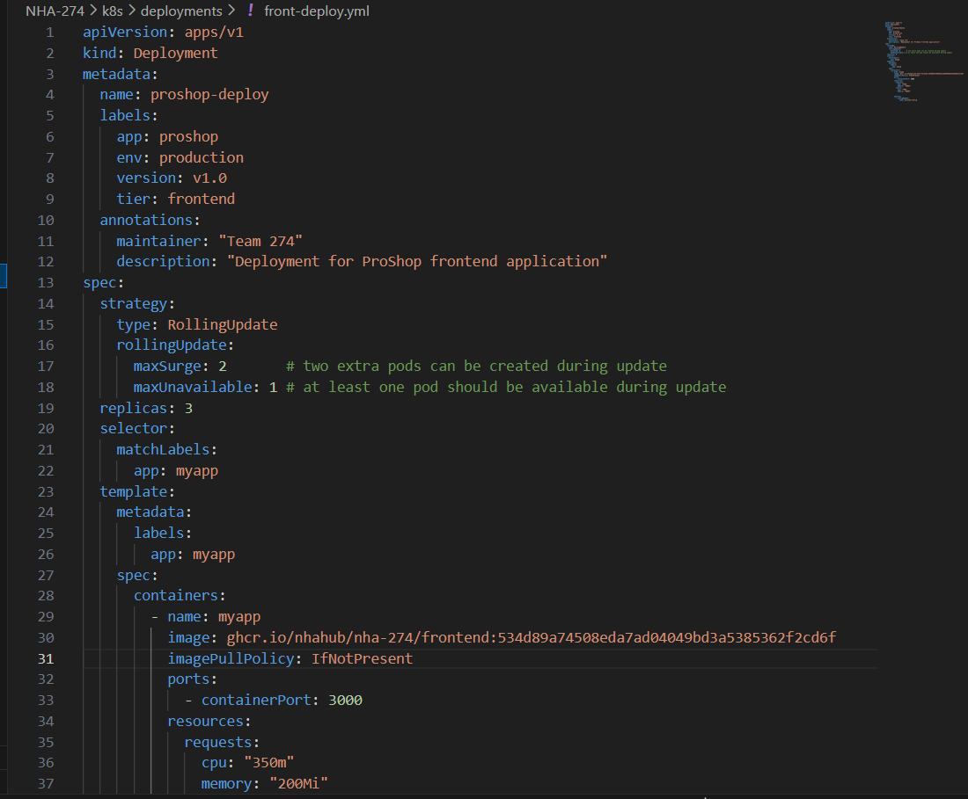
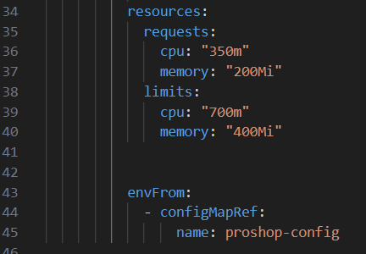
Deployment

Slide 28
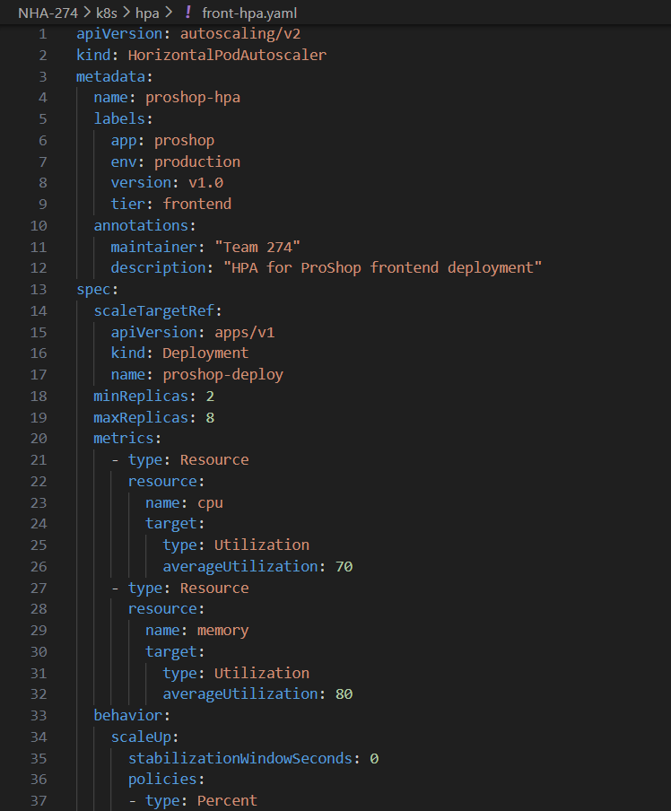
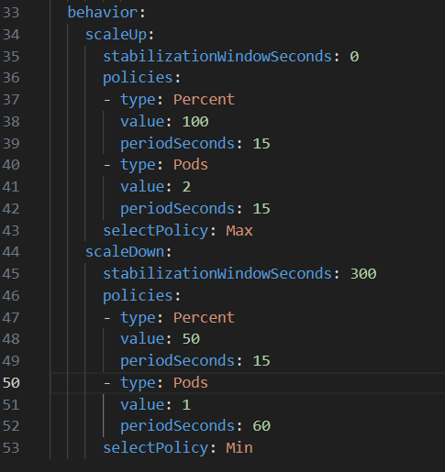
HPA

Slide 29
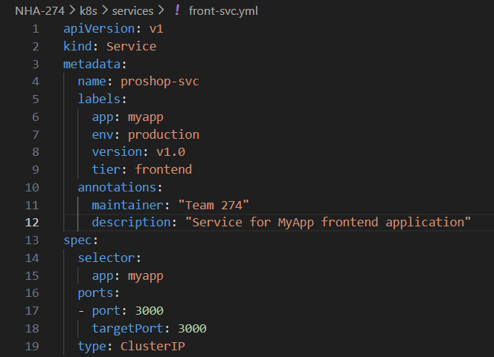
Services

Slide 30
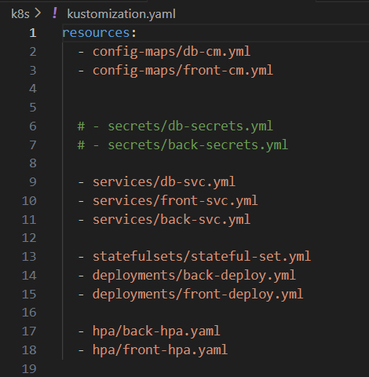
Kustomization

Slide 31
04
Pipeline

Slide 32
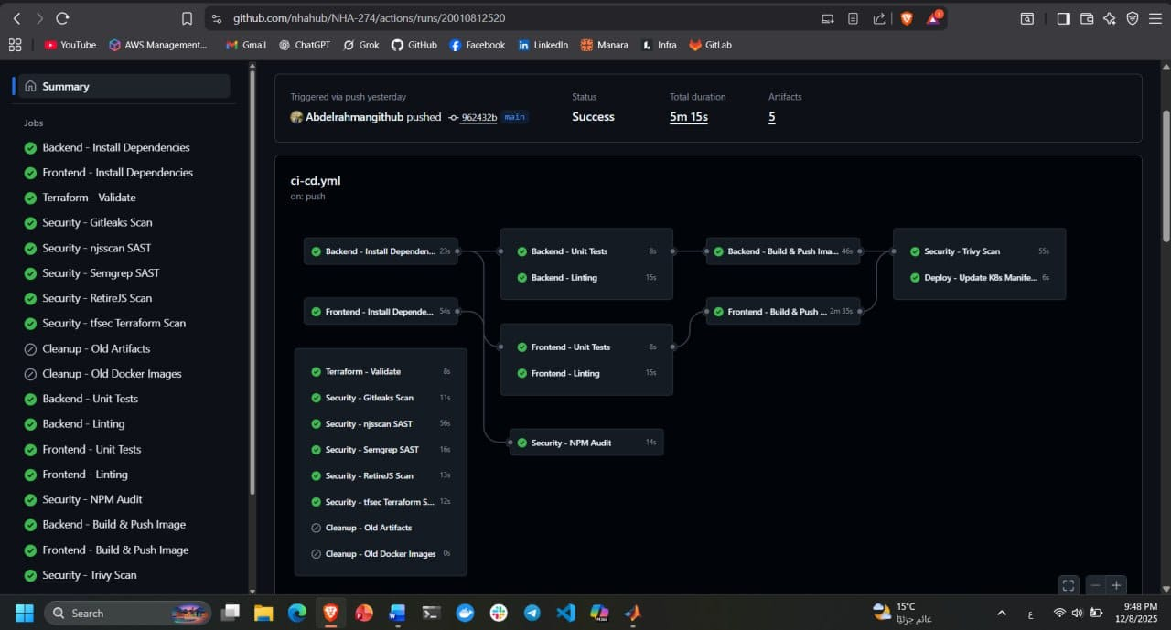
Using Gitlab, Our stages

Slide 33
DevSecOps
Security
Trivy
semgrep
Gitleaks
NJSScan
Retire.js
Image scanning
Static application security testing
Search for secrets in code
JS security scan
Known JS vulnerabilities

Slide 34
DevSecOps
Security
npm audit
tfsec
Owasp
Dependency vulnerabilities
Infra Scanning
All the Previous achieve Top 10 Owasp vulnerabilities

Slide 35
DevSecOps
Dev & Ops
Dev
Ops
Ops
Install and test
Build Docker Image
K8s Deploy

Slide 36
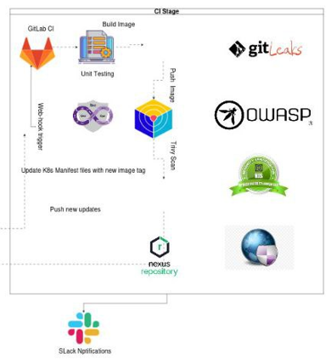
Here is our Full CI stage
Before Going to CD stage let’s apply GitOps concept

Slide 37
GitOPS

Slide 38
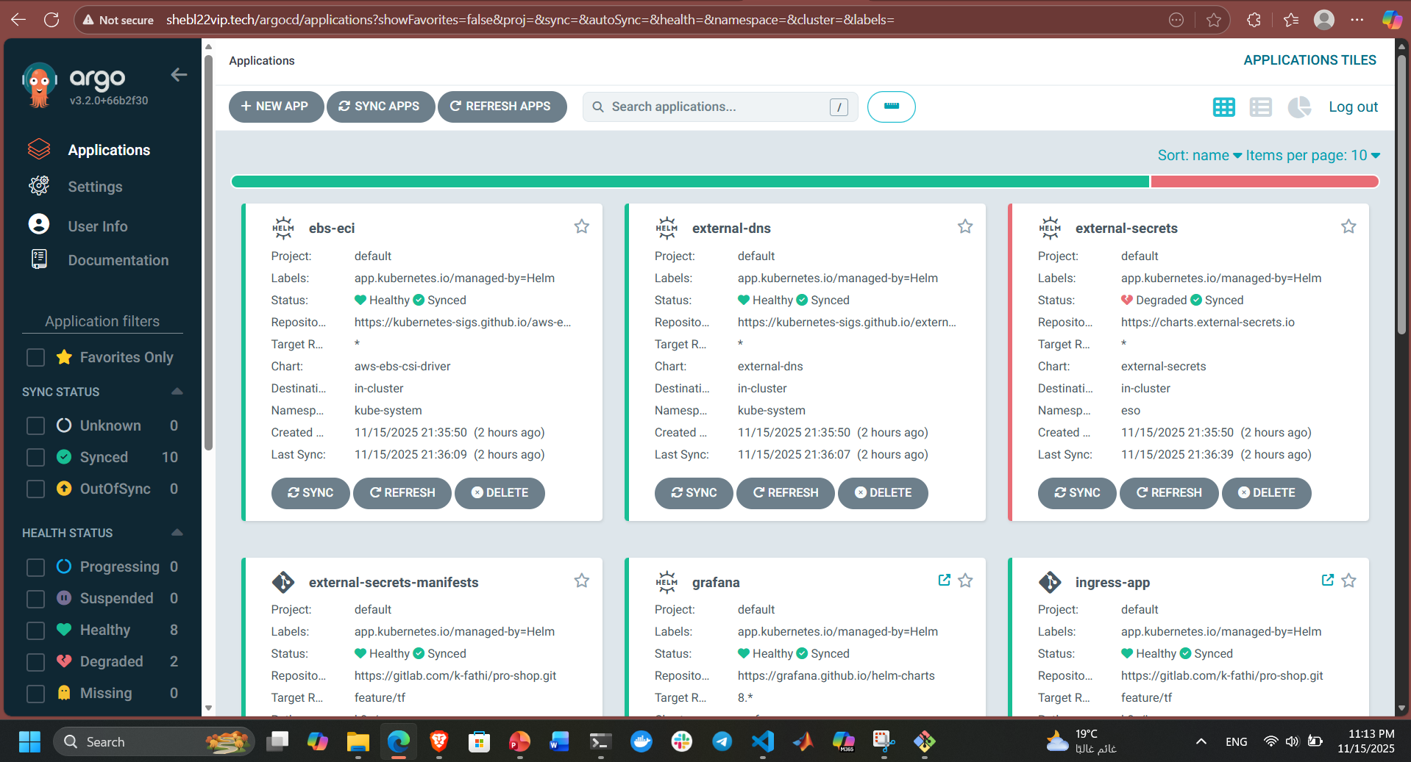
ArgoCD

Slide 39
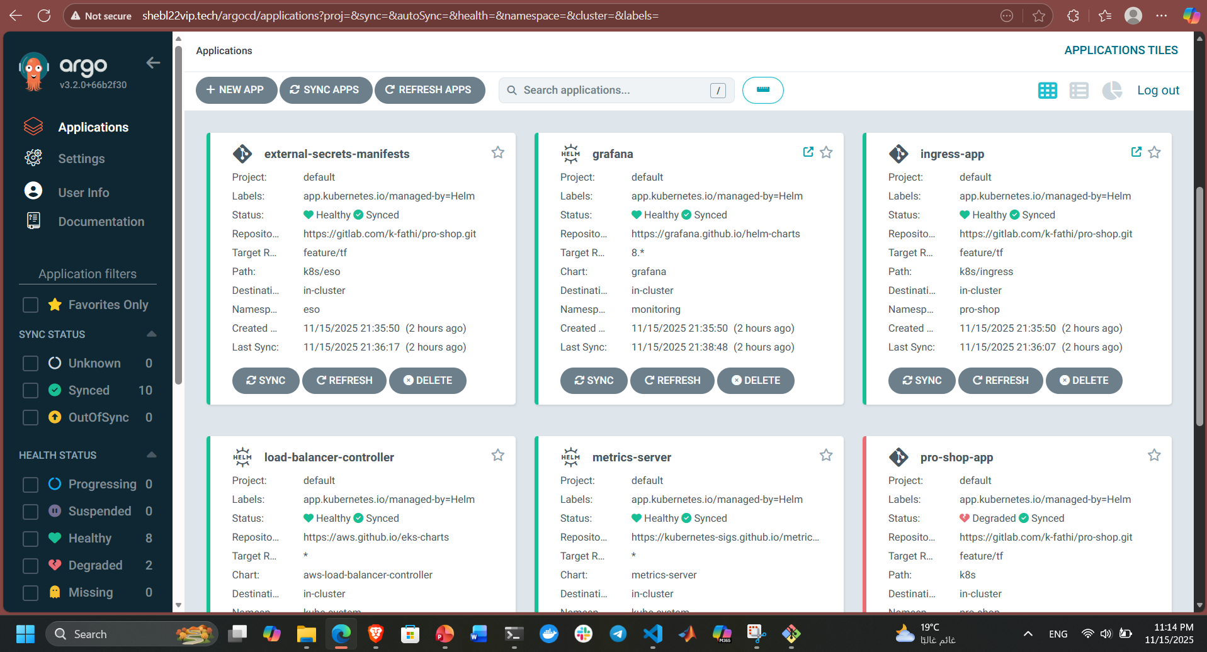
ArgoCD

Slide 40
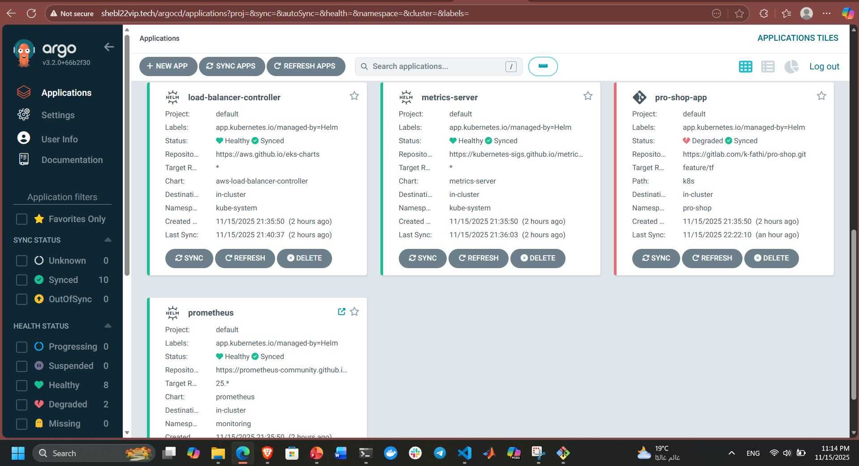
ArgoCD

Slide 41
05
IaC-Terraform

Slide 42
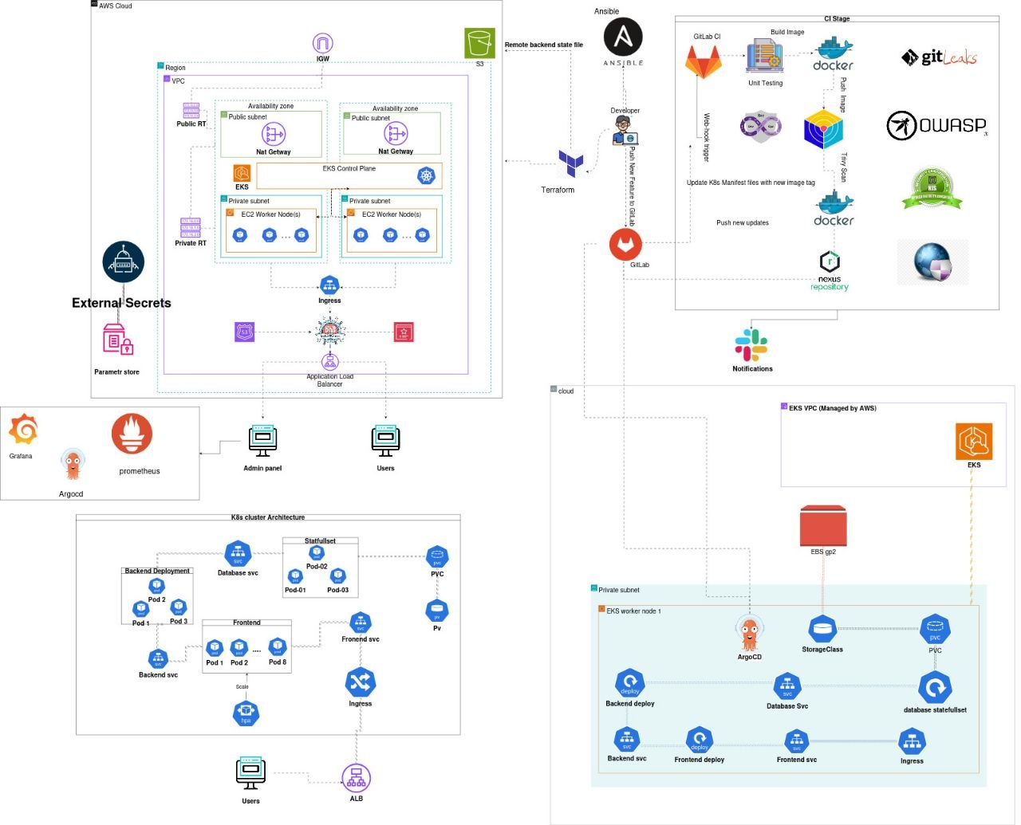

Slide 43
06
Helm

Slide 44
Monitoring &
Observability

Slide 45
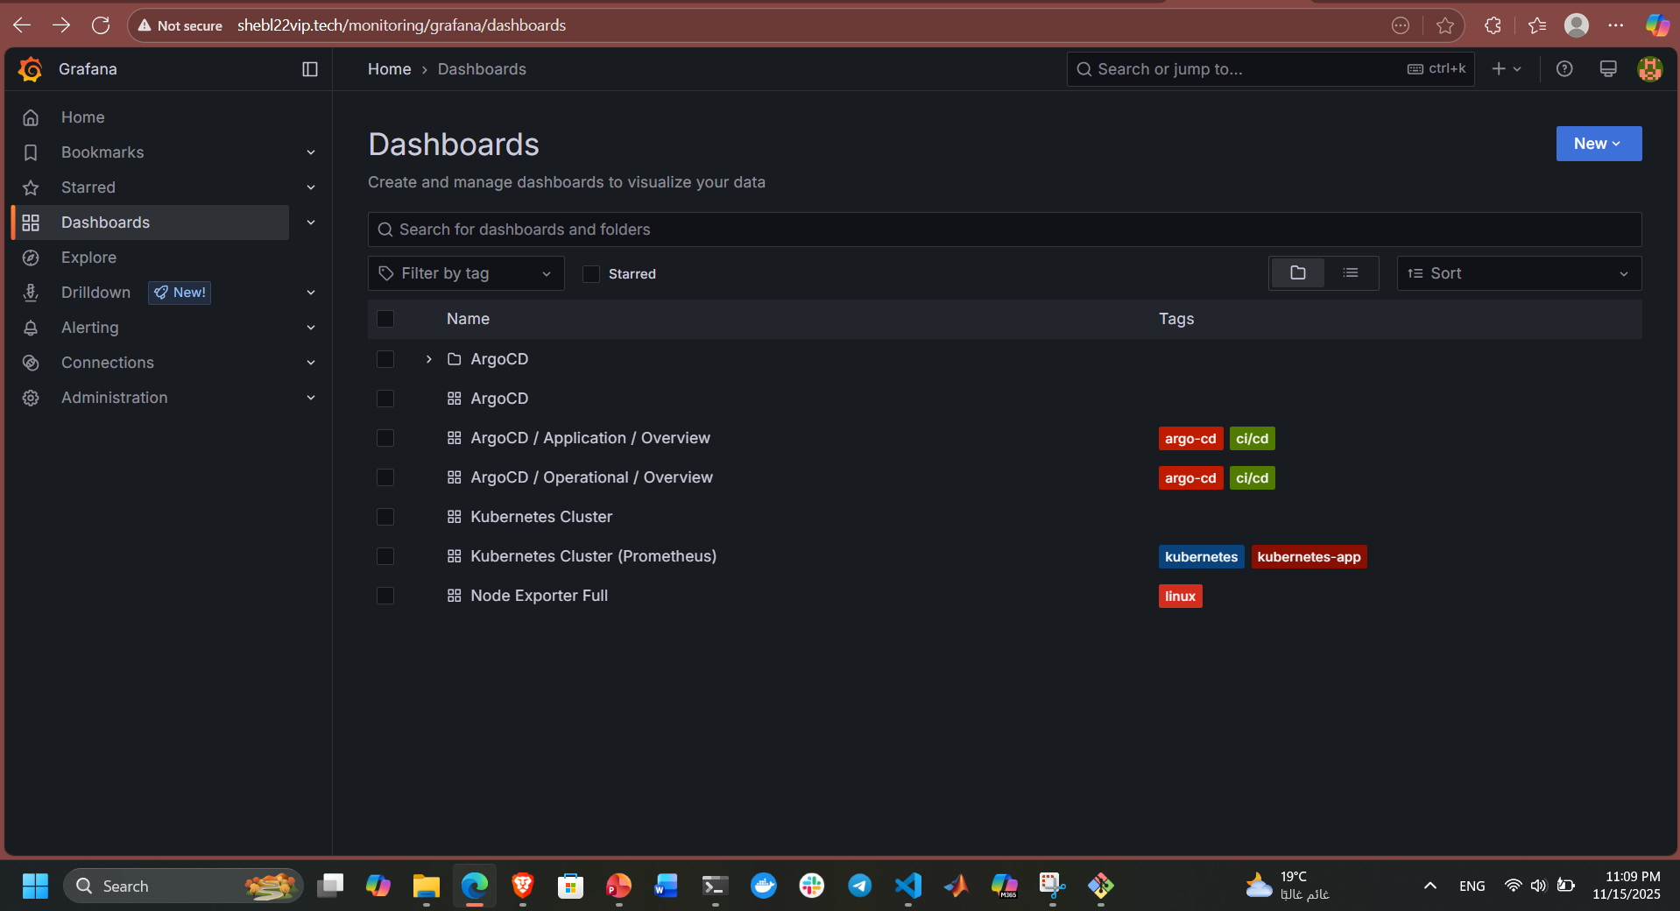
Grafana

Slide 46
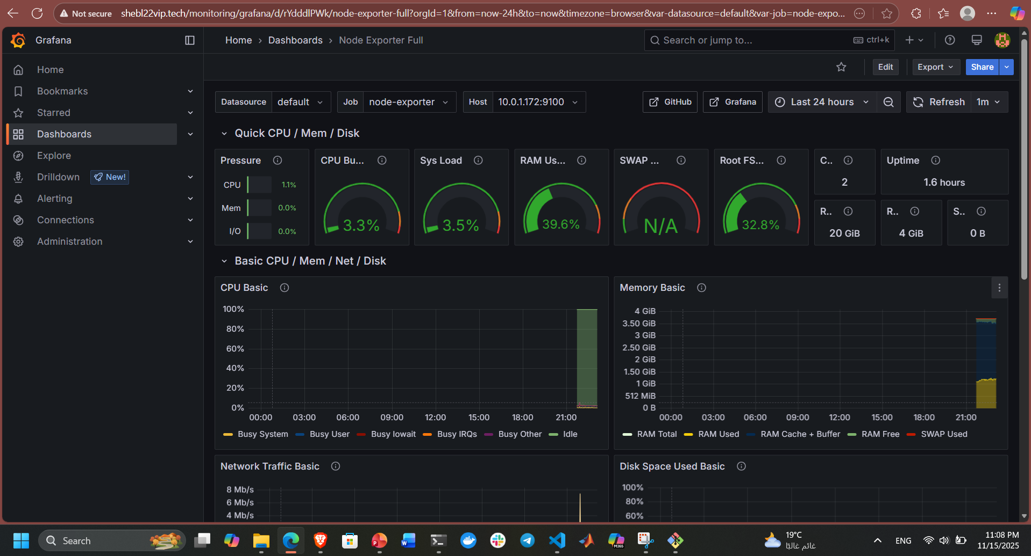
Grafana

Slide 47
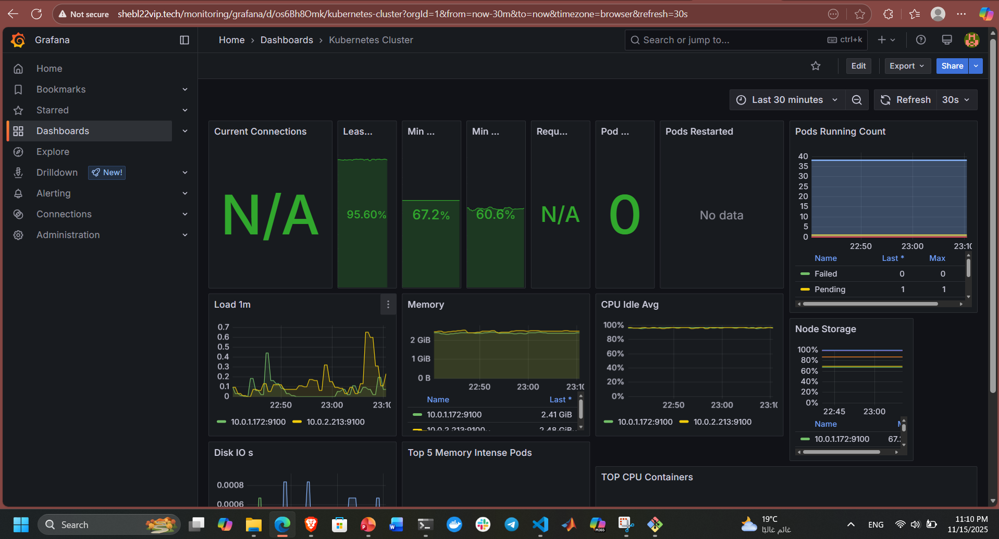
Grafana

Slide 48
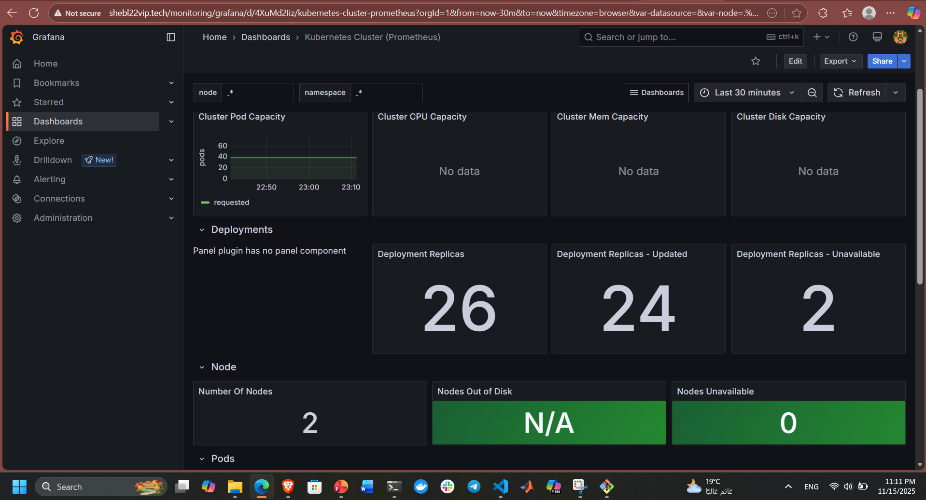
Grafana

Slide 49
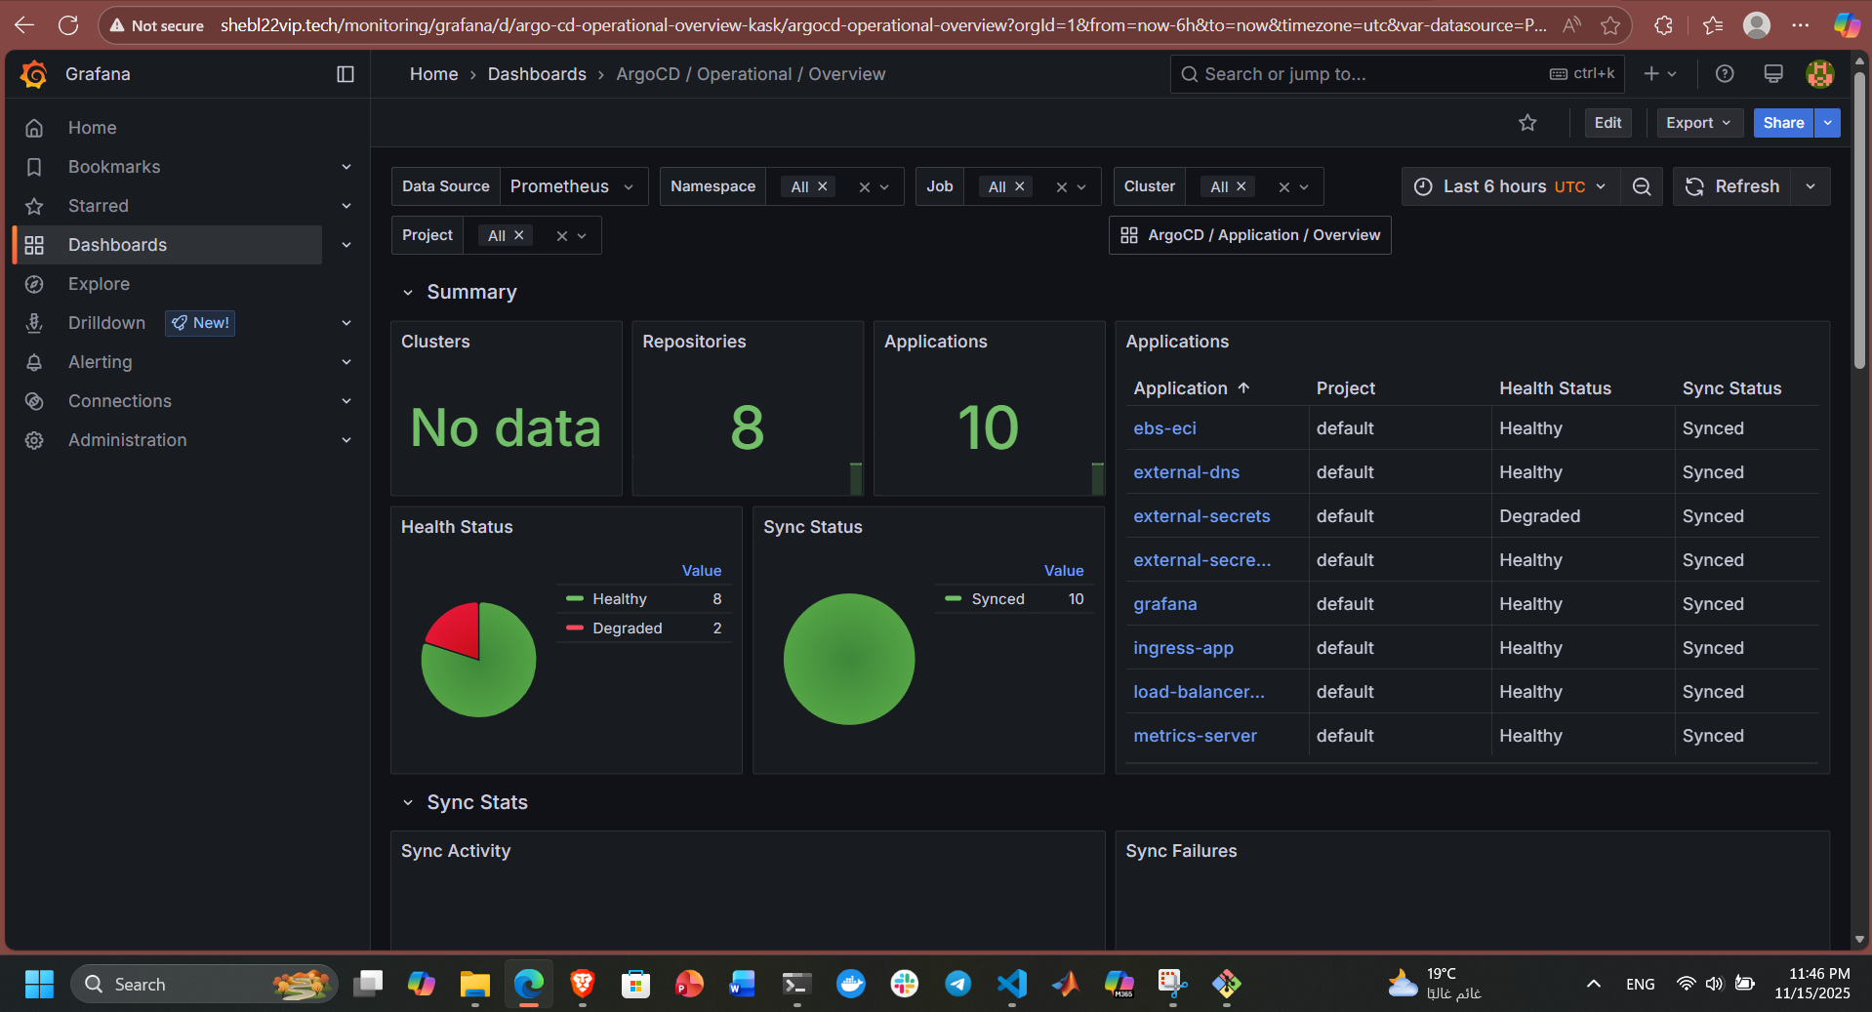
Grafana

Slide 50
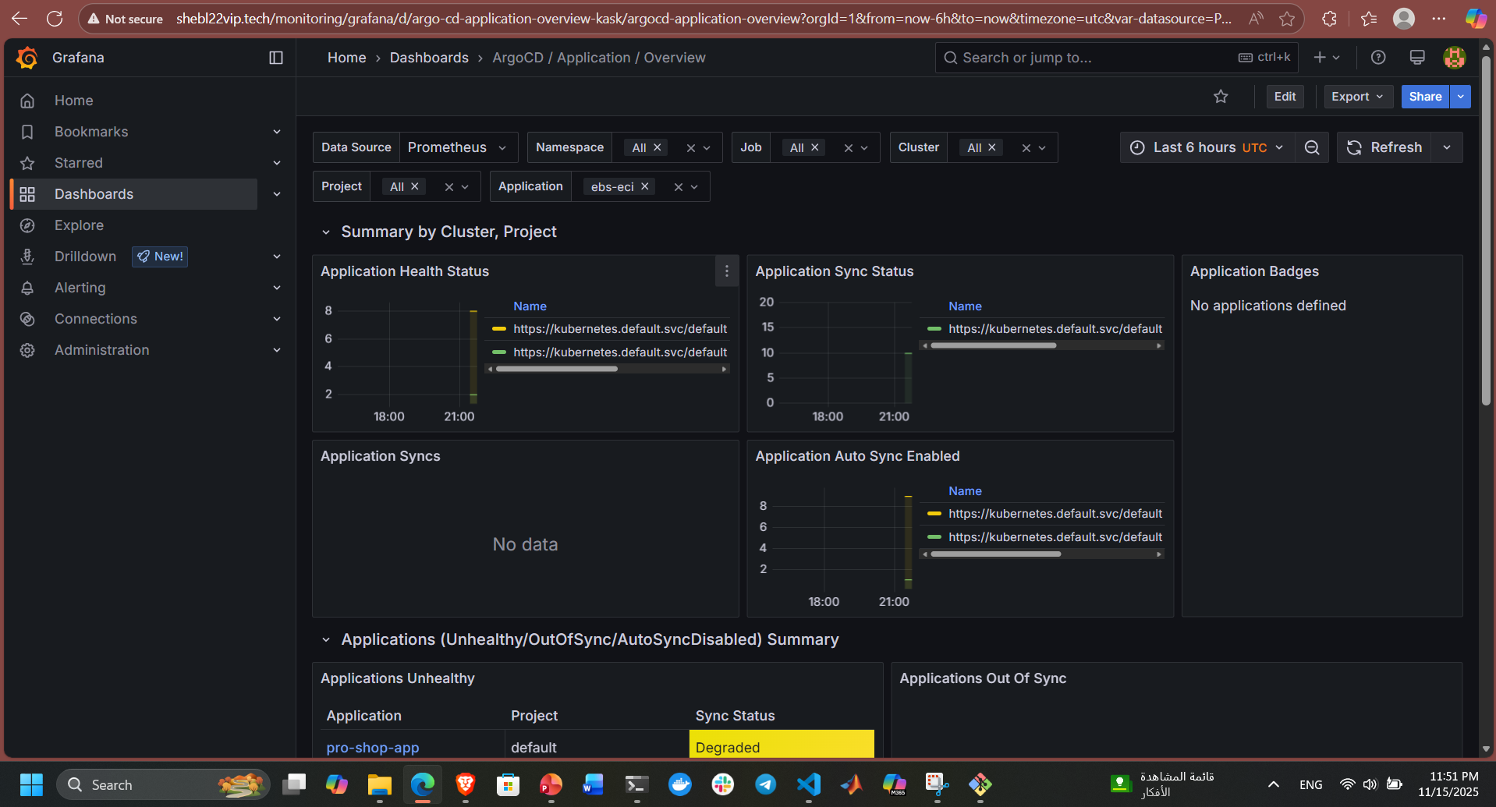
Grafana

Slide 51
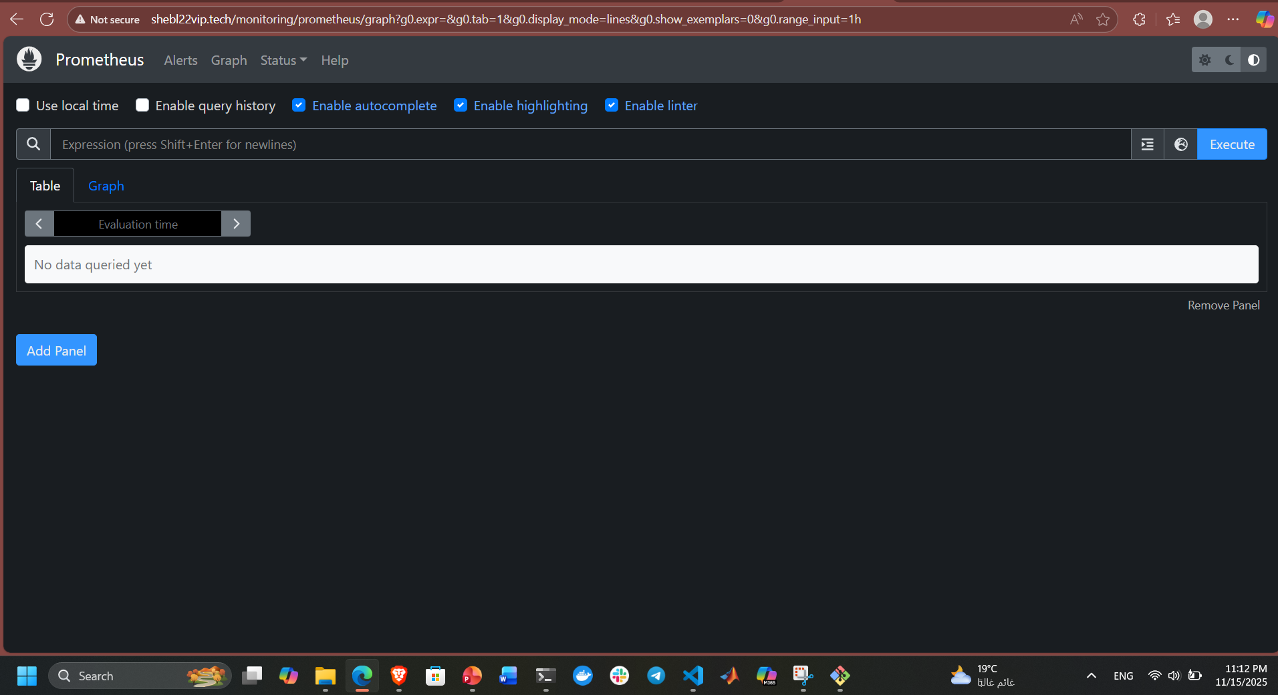
Prometheus

Slide 52
07
Ansible

Slide 53
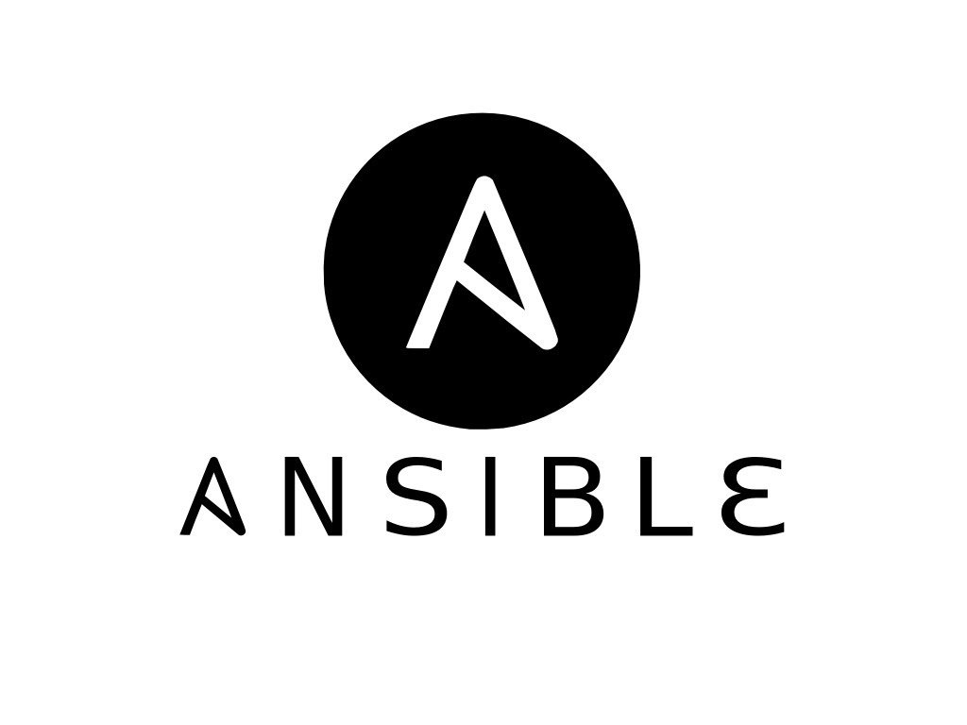
-
-
install Docker if missing.
-
check the operating system,
install required packages,
prepare the project folder, copy the needed files, and starts the Docker Compose stack.
After deployment, it waits for the app to start and shows the access URL. It also supports a cleanup mode that stops the stack and removes the project directory.

Slide 54
08
MakeFile

Slide 55
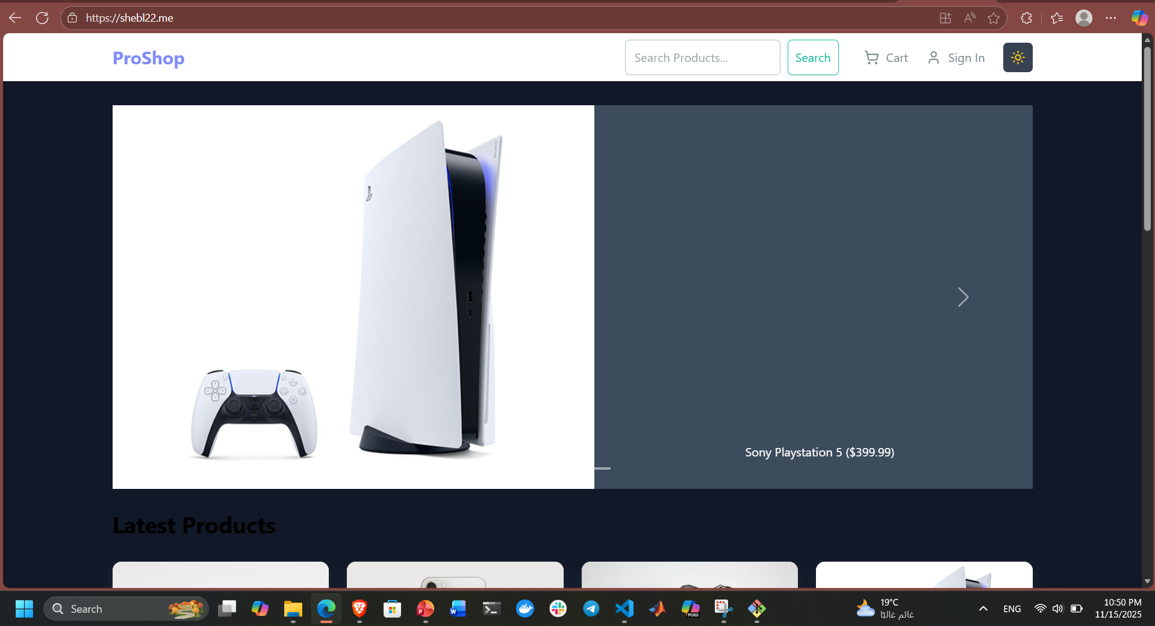
Finally our App

Slide 56
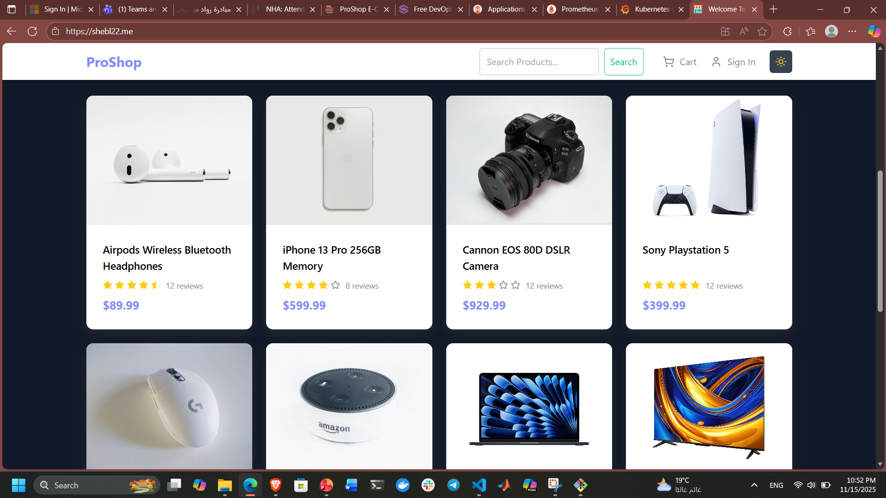

Slide 57
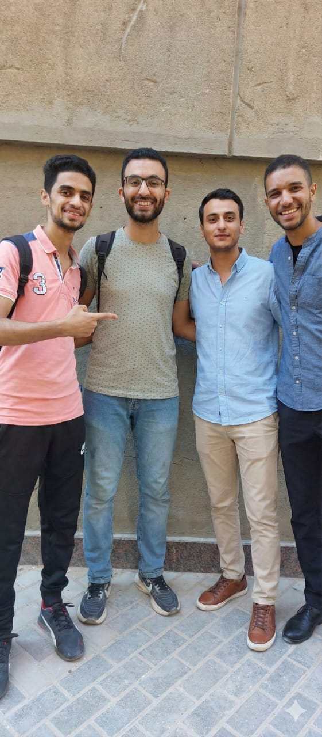
Thank You
Team 274

